Slide 1

Knowledge Graphs
How to Create a Knowledge Graph from Text?

Slide 2
Outline
Overview
Language Models
Entity Extraction
Relation Extraction
Summary

Slide 3
Overview
Lot of valuable information is available in text
SEC Filings
Wall Street Journal
Financial News
We can use natural language processing (NLP) for information extraction
This module is not in-depth discussion of NLP
Focus is to use NLP as a black box in service of KG construction

Slide 4
Overview
Key tasks in Information Extraction
Entity extraction
People, Companies, Places, etc.
Relation extraction
works_for, has_location, has_address
Entity resolution
“John Smith”, “He”, “The company president”

Slide 5
Overview
Key tasks in Information Extraction
Entity extraction
People, Companies, Places, etc.
Relation extraction
works_for, has_location, has_address
Entity resolution
“John Smith”, “He”, “The company president”
Language Models

Slide 6
Language Models
A language model predicts what word comes in the text next
Given: “students opened their …..”
Predict the next word: books, laptops, exams, etc.

Slide 7
Language Models
A language model predicts what word comes in the text next
Given: A set of words x₁,…,x_{n-1}
Predict: P(x_{n} | x₁,…,x_{n-1})

Slide 8


Language Models
Practical Applications
Autocompleting search queries
Auto completion while typing on a phone

Slide 9
Language Models
Created using deep learning models
Recurrent Neural Networks is a popular approach
Several variations of pre-trained language models are available
Data used for training
Single direction or Bi-direction
Specific neural architecture used
Available off-the-shelf and can be adapted for task at hand

Slide 10
Entity Extraction
Example
Approaches to Entity Extraction
Challenges

Slide 11
Example
Cecilia Love, 52, a retired police investigator who lives in Massachusetts, said she paid around $370 a ticket with tax for nonstop United Airlines flights to Sacramento from Boston for her niece's high school graduation in June, 2020.

Slide 12
Example
Cecilia Love, 52, a retired police investigator who lives in Massachusetts, said she paid around $370 a ticket with tax for nonstop United Airlines flights to Sacramento from Boston for her niece's high school graduation in June, 2020.
A named entity is anything that can be referred to using a proper name
Places, Companies, People, etc.
Extended to include dates, times, numerical expressions

Slide 13
Example
Cecilia Love, 52, a retired police investigator who lives in Massachusetts, said she paid around $370 a ticket with tax for nonstop United Airlines flights to Sacramento from Boston for her niece's high school graduation in June, 2020.
[PER Cecilia Love], 52, a retired police investigator who lives in [LOC New Jersey], said she paid around [MONEY $370] a ticket with tax for nonstop [ORG United Airlines] flight to [LOC Sacramento] from [LOC Boston] for her niece's high school graduation in [TIME June, 2020].

Slide 14
Approach to Entity Extraction
We view entity extraction as a sequence labeling problem
For each word in the input, assign a label from [B, E, I, O, S]
B – First word in the entity
E – Last word in the entity
I – Internal word in the entity
O – Word not in the entity
S – Single word entity

Slide 15
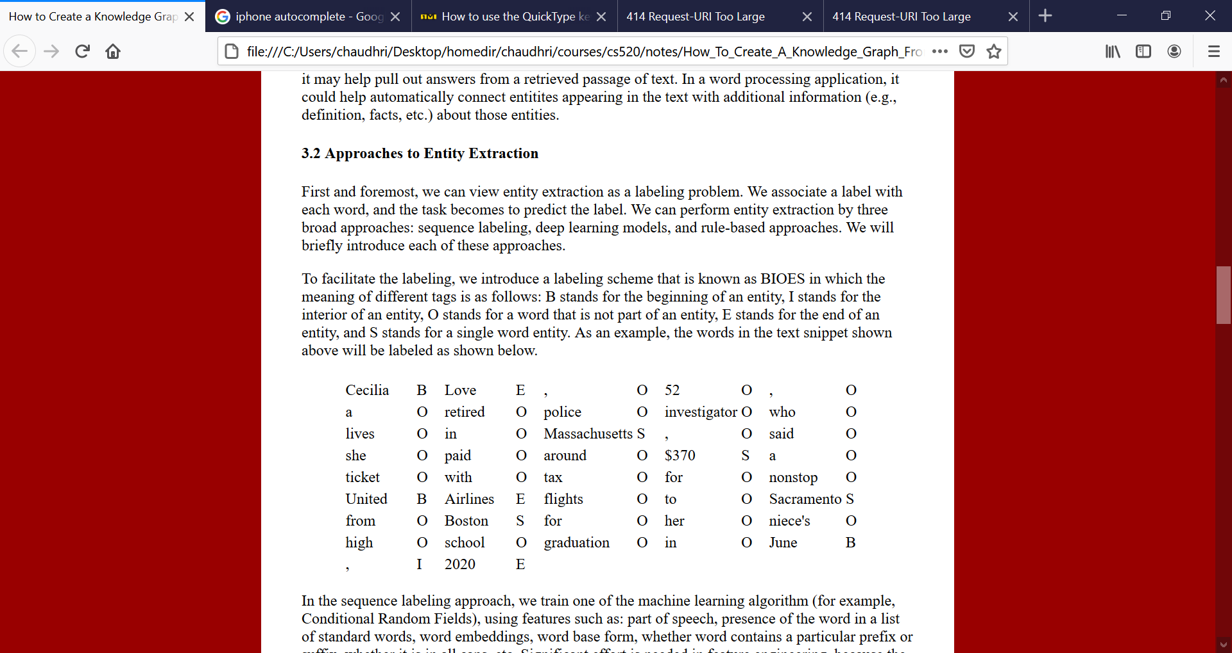
Approach to Entity Extraction
We view entity extraction as a sequence labeling problem
For each word in the input, assign a label from [B, E, I, O, S]

Slide 16
Approach to Entity Extraction
Three broad categories of approaches
Sequence Labeling
Neural Models
Rule-based

Slide 17
Approach to Entity Extraction
Sequence labeling
Train a machine learning algorithm (e.g., Conditional Random Fields) using features such as:
Part of speech
Presence in a named entity list
Word embedding
Word prefix
Whether the word is in all CAPS
Significant Feature Engineering is Required

Slide 18
Approach to Entity Extraction
Adapt a Language Model
Task-independent training
Train the model on the domain of interest
Task-dependent training
Introduce special tags in the input
[CLS] Cecilia Love [SEP], 52, a retired police investigator who lives in [CLS] New Jersey [SEP], said she ……

Slide 19
Approach to Entity Extraction
Adapt a Language Model
Task-independent training
Train the model on the domain of interest
Task-dependent training
Introduce special tags in the input
[CLS] Cecilia Love [SEP], 52, a retired police investigator who lives in [CLS] New Jersey [SEP], said she ……
Language model now predicts the occurrence of a distinguished token

Slide 20
Approach to Entity Extraction
Rule-based approach
Express the extraction rules in a formal rule language
The rules can be based on
Regular expressions
References to dictionary
Invoke custom extractors

Slide 21
Challenges in Entity Extraction
Ambiguity
Louis Vouitton – Can be company, person, or product
Training Data
Data is usually small and incomplete
Domain-specific Variations
Duplication of a cell by fission
Attach
Many different forms of an entity
Need to have a lexicon

Slide 22
Relation Extraction
Examples
Approaches to Relation Extraction
Challenges

Slide 23
Relation Extraction
Example
Cecilia Love lives in Massachusetts
United Airline flies from Boston
United Airlines flies to Sacramento
Cecilia Love, 52, a retired police investigator who lives in Massachusetts, said she paid around $370 a ticket with tax for nonstop United Airlines flights to Sacramento from Boston for her niece's high school graduation in June, 2020.

Slide 24
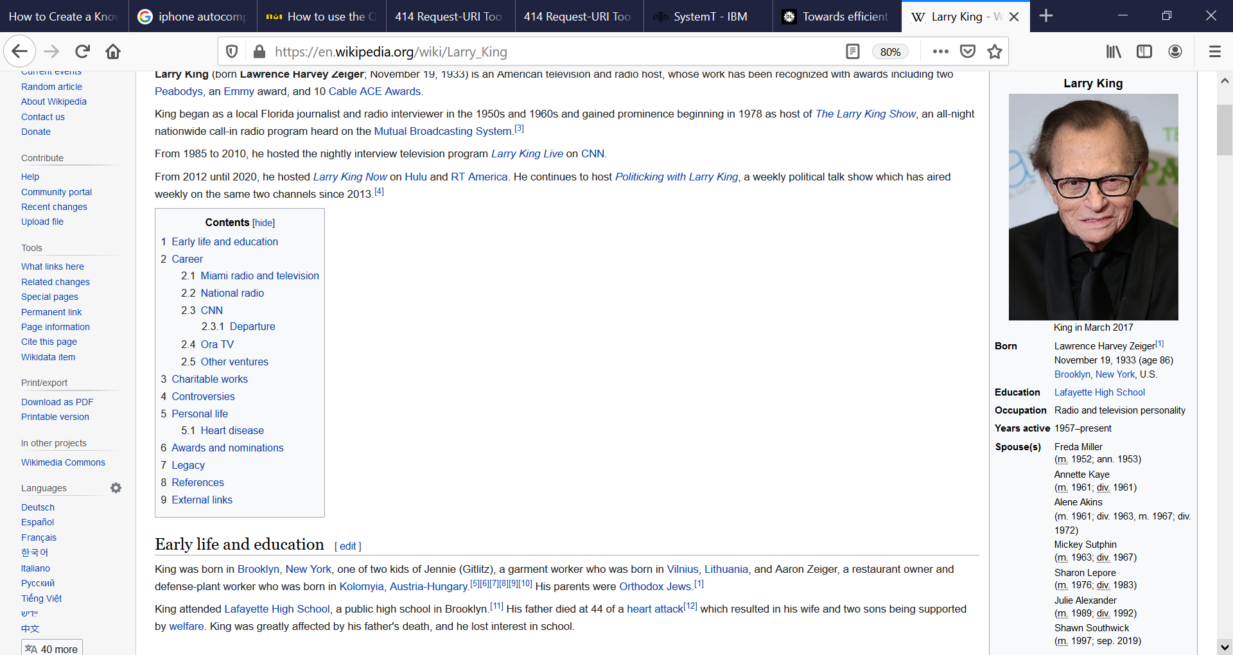
Relation Extraction
Example
Extracting information from Wikipedia Infoboxes

Slide 25
Relation Extraction
Domain-specific relation extraction
Unified medical language system
causes, treats, disrupts

Slide 26
Approaches to Relation Extraction
Syntactic patterns (or rule-based)
Supervised learning
Open information extraction

Slide 27
Approaches to Relation Extraction
Syntactic patterns (or rule-based)
Supervised learning
Open information extraction
Does not rely on a designed set of relations
Can be difficult to use / understand the relations

Slide 28
Approach to Relation Extraction
Syntactic patterns (aka Hearst Patterns)
The bow lute, such as the Bambara ndang, is plucked and has an individual curved neck for each string.

Slide 29
Approach to Relation Extraction
Syntactic Patterns (aka Hearst Patterns)
The bow lute, such as the Bambara ndang, is plucked and has an individual curved neck for each string.
Even though we have never heard of Bambara ndang,
but we can extract that it is a kind of bow lute

Slide 30
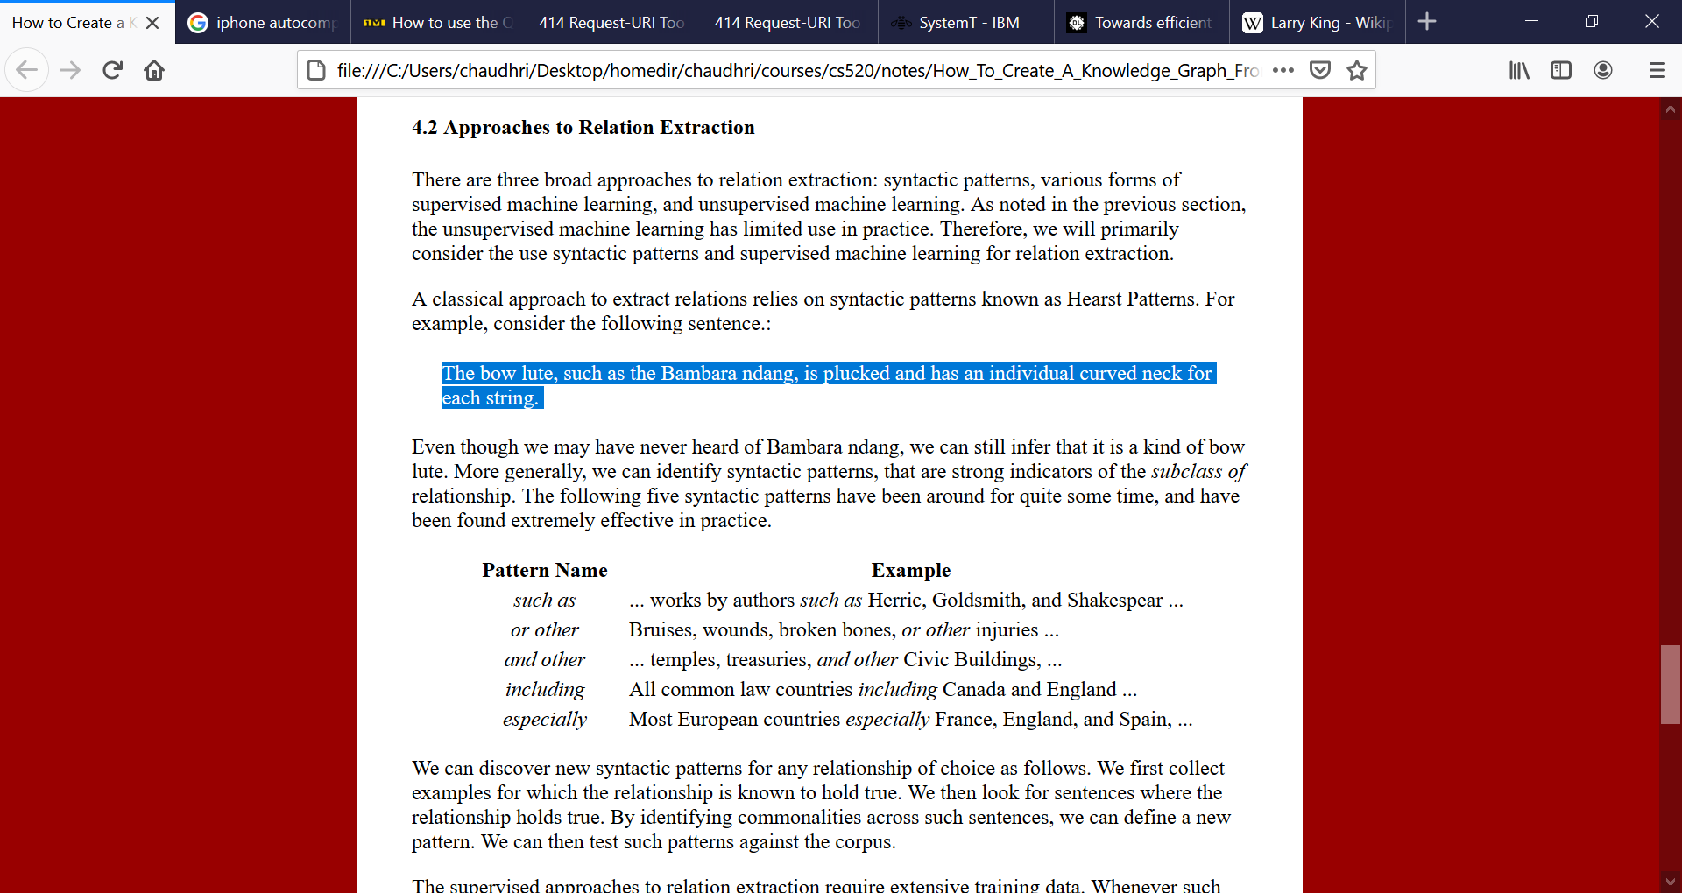
Approach to Relation Extraction
Syntactic Patterns

Slide 31
Approach to Information Extraction
Syntactic Pattern
To discover pattern for a new relation collect several examples
Look for generalities to discover new patterns
Has been difficult to find patterns for some relations, e.g., has part
Limited success in automatically learning the patterns

Slide 32
Approach to Relation Extraction
Supervised learning
Requires a huge amount of training data
We can use syntactic patterns to generate training data
We can also write approximate labeling functions
An approximate labeling function for has_part is to produce a dependency parse of a sentence, and look for nodes directly connected by “has” or “have”
An approximate labeling function for subclass_of: If two entities end with the same base word but one has an extra modifier (e.g., cell and eukaryotic cell)

Slide 33
Approach to Relation Extraction
Adapting Language Model
[TERM1-START] Cecilia Love [TERM1-END], 52, a retired police investigator who lives in [TERM2-START] Massachusetts [TERM2-END]
For training data such as the sentences above, we provide the relational label as the output
The model then learns to predict the labels for input sentences as augmented above

Slide 34
Challenges to Relation Extraction
Training Data
Human Verification
Specialized extraction for
Events
Temporal information

Slide 35
Summary
Entity extraction and relation extraction are fundamental problems to creating knowledge graphs from text
Use of rule-based methods for training data generation that can be fed into pre-trained language models is becoming an increasingly popular paradigm
Entity linking and resolution will eventually play an important role

